Slide 1
Module – Groundwater Level Measurement

Slide 2
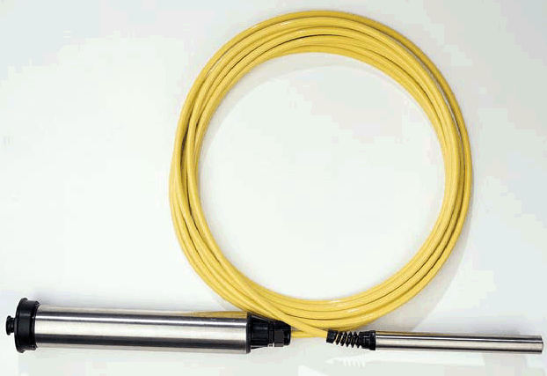
Ground Water
Concept
Continuous ground water levels are most commonly measured with a submersible pressure transducer
The measured pressure is converted to water depth over the sensor and from that depth to water from the surface can be calculated

Slide 3
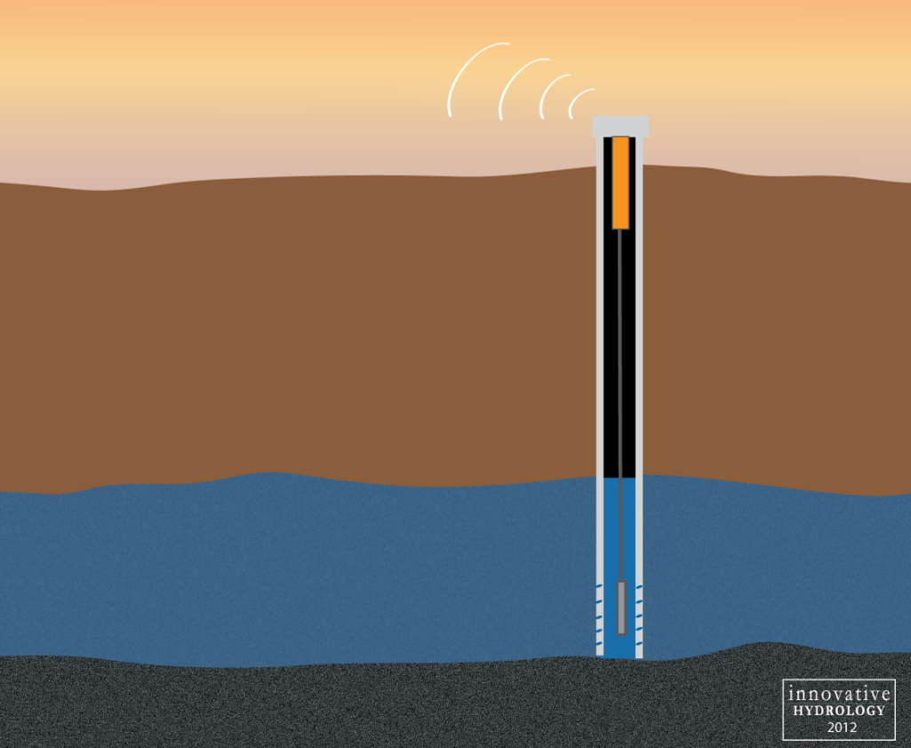
Ground Water Applications
External Data Logger
Suited towards adding additional equipment to data loggers such as rainfall, evaporation, or other hydromet measurements
Internal Data Logger
Standalone system for just ground water level recording
Internal batteries
No solar panels required
Additional features such as GPRS and water quality

Slide 4
Ground Water Continued
Other options
Vented cable compensates for barometric pressure changes
Non-vented cable requires post-processing to determine water level

Slide 5
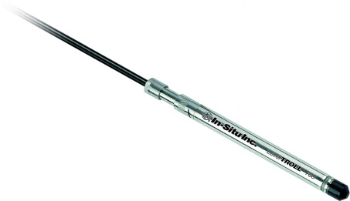
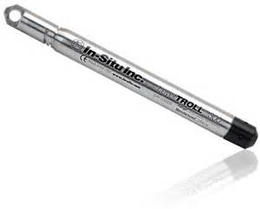
DWLR Options
Sensor with Vented Pipe
Sensor without Vented Pipe
Barometric Pressure correction with different sensor
DWLR without Telemetry
Just the steel wire and data-logger, no telemetry

Slide 6
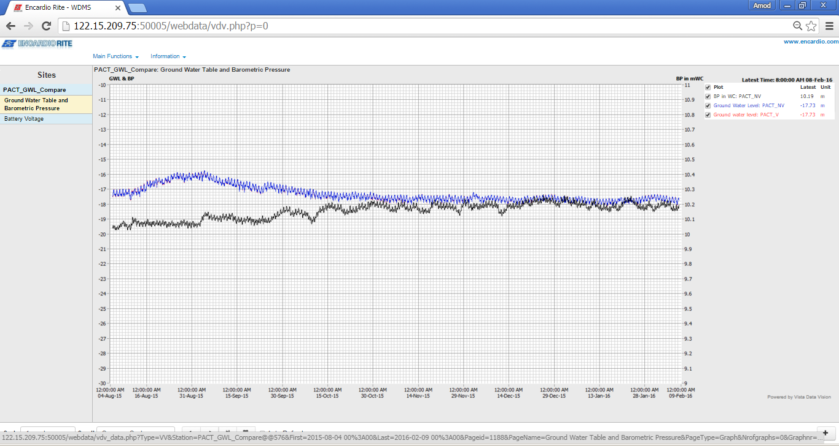
Vented Vs Non Vented

Slide 7
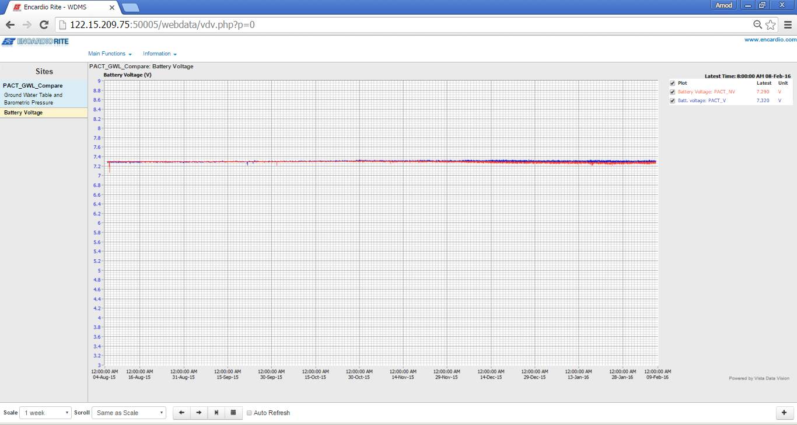
Battery Voltage

Slide 8
Specifications
Pressure sensor
Sensor Type | Vented Gauge Pressure Sensor or Non Vented Pressure Sensor with Barometric Pressure Correction for Individual Sensor *See Explanatory note below the table.
Measuring Range | 0-50 m (water column) : However, the full scale measuring range and installation depth will be specified by the implementing Agency depending upon their local requirements.
Overall Accuracy | 0.1% Full Scale or better
Temperature Coefficient | <0.01% Full scale/degree centigrade for water temperatures between 10 degree centigrade and 40 degree centigrade
Reproducibility | 0.05% full scale or better.
Long Term Stability | 0.1% Full Scale or better and should ensure long term stability without any field calibration requirements.
Burst pressure | >3 times Full scale.
Overload pressure | 2 times full scale or better, without effect on calibration.
Over voltage protection on supply & sensor wires | Over voltage protection should be provided on power supply lines.

Slide 9
Data logger
Resolution of measurement | 1 mm or better
Measuring interval | Should be programmed to store data from 1 minute one reading to 24 hours one reading
Settling up Time | < 30 minutes after submersion.
Recording capacity | Non-Volatile flash data storage of more than 200000 data points (at least).
Memory type | Non-Volatile Memory
Power supply | Should be equipped with lithium or alkaline battery pack, giving at least 2 years operation .Batteries must be replaceable in the field or in local offices of the Implementing Agency or supplier .Replacement batteries must be easily available in India
Communication Interface | The logger must be capable of connection to a computer via USB 2.0 or better and supply should include the necessary interface cables. The logger must be capable of connection to a telemetry system
Operating temperature | Up to 60°C
Operating humidity | Up to 100 %
Built in clock | Accurate to ± 1 minute per month
Displayed time resolution | 1 second or better
Over-voltage protection | Should include lightening, over voltage and surge protection

Slide 10
Enclosure
Enclosure for Pressure sensor and data logger | Data logger should be concealed into a single tubular enclosure, which is waterproof and corrosion proof.
Dimensions | Outer diameter : < 75 mm
Material | Titanium, Stainless Steel or other corrosion resistance material
Installation | The data logger should be provided with a suspension bracket allowing secure installation within the Piezometers’ head-works, including appropriate cable mounting to allow the sensor to be adjusted to the required depth, in a stable and reproducible manner.
Ambient Condition | Up to 60 ⁰ C and 100% humidity

Slide 11
Cable
Strength members for good longitudinal stability of cable.
Incorporated PTEF or equivalent vent tube for barometric air pressure compensation of the vented gauge pressure sensors (applicable only in case of vented sensor, not applicable for Non-Vented Sensor with barometric correction sensor)
A moisture blocking system based on a hydrophobic filter and desiccators, to prevent condensation of water in the vent tube and in the sensor. The desiccant shall be replaceable. (applicable only in case of vented sensor, not applicable for Non-Vented Sensor with barometric correction sensor)
The desiccant capacity should be adequate for at least 6 months of unattended operations under the worst environmental conditions. For each instrument, two desiccant replacements should be part of the delivery. (The total desiccant shall be three including the two replacements) (applicable only in case of vented sensor, not applicable for Non-Vented Sensor with barometric correction sensor)
The cable and contacts should be fixed or quick connect.
Cable should have good flexibility and durability.
Should be of Polyurethane Jacket or better
The electrical wires shall have sufficient conductivity to allow for extension of the cable to up to 150 mt without degrading accuracy, stability and data communication

Slide 12
Telemetry System
Telemetry System | GSM/ GPRS/edge based data transmission system with at least two years power backup (see supplementary Specification) Bidder is to acquire, manage, and operate a data collection, storage, processing, and dissemination to support the activities as shown in Annexure-1. The bidder shall arrange cloud server as primary server (meeting requirements given in Annexure-1 (at next page) and a hardware server/storage system for additional backup to be kept with the purchaser
Data Retrieval/Receiving System (DRS) | The bidder will do Software uploading on server at purchaser’s end to receive data from DWLRs and transmit data to website, as a backup to cloud server requested for. Note: A data receiving facility (along with a server, peripherals and other required Operating system, hardware, etc.) shall be purchased separately by the purchaser.
DRS cable | DRS cable of 1 meter length capable to connect DWLR with laptop for data receiving.

